Slide 1
Spotify Music Recommendation System
Presented by Hackathon Team 3

Slide 2
Project Aim
The aim of this project was to assess whether audio features and genre classifications could be used to Create Song Recommendations based on sound profiles.

Slide 3
Data Transformation
Removed Unncessary Columns
Feature Engineering
Handled Duplicate Tracks
Handled Missing Values
Dealt with Multi-Valued Tracks

Slide 4
Cleaning Duplicates
Track name
Song name
Album name
Track genre
Danceability
Popularity
Liveness
Tempo
Remove duplicate Track IDs
Remove duplicates when Song name, Album and Artists align
Remove duplicates when numerical Song profile is aligned (numerical features)

Slide 5

Neural Networks 1.0 Data Prep
Cetegorizing Music Genres

Slide 6
New feature created by categorising song genre into subset listening category
Feature Engineering
Music Genre
Listening Category
Song Profile
113 Genres: e.g, honky-tonk, soul, opera, drum-and-bass
11 Categories: e.g, country-folk, jazz-blues, classical, electronic, respectively

Slide 7
Neural Networks 2.0 Song Recommendation App
TensorFlow python Library

Slide 8
Model Training Logic
Embedding layers: trainable vectors per token
Dense layers: learnable weight matrices and biases that transform and mix feature layers can learn joint (cross‑modal)interactions between audio profiles andgenre to produce the final song embedding
BatchNormalization: has learnable scale/shift parameters (and normalizes activations during training).
Embedding
Flattened and Concatenated Vectors
Dense
Learning Matrix Creates Final Song Embedding
KNN
Retrieve top‑K nearest indices (highest similarity)

Slide 9
Neural Network - The 3 Embedding Vectors
Layer 1 Music Category
Pop
Rock
Electronic
Layer 2 Music Genre
Layer 3 Song Profile Scores
Popularity
Danceability
Hiphop/RnB
World
Metal
Dance
Club
Classical
Niche
113 specific music genres such as:
Indie-pop, K-Pop
Rock, Garage
Country, Folk
Disco, Reggaeton
Singer-songwriter
Energy
Accousticness
Instrumentalness
Liveness
Valence
Tempo
Loudness
Music Category vector → 8 numbers per song
Track Genre vector → 24 numbers per song
Combined Genre vector → 32 numbers per song (24 + 8)
Song Profile vector → 64 numbers per song

Slide 10
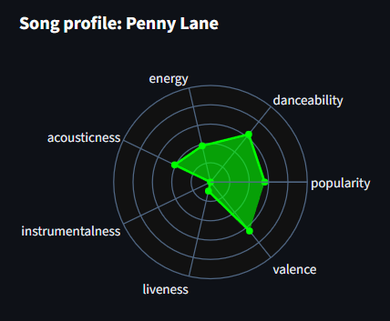
​Final Embedding Layer - Sound Profiling
danceability | energy | loudness | speechiness | acoustic
0.676 | 0.461 | -6.746 | 0.143 | 0.0322
instrumentalness | liveness | valence | tempo
1.01E-06 | 0.358 | 0.715 | 87.917
The song profile branch takes the song’s continuous sound/profile features (e.g., popularity, danceability, energy, acousticness, etc.), normalizes them , and projects them into a learned representation (third vector).
This outputs a 64‑number vector per song

Slide 11
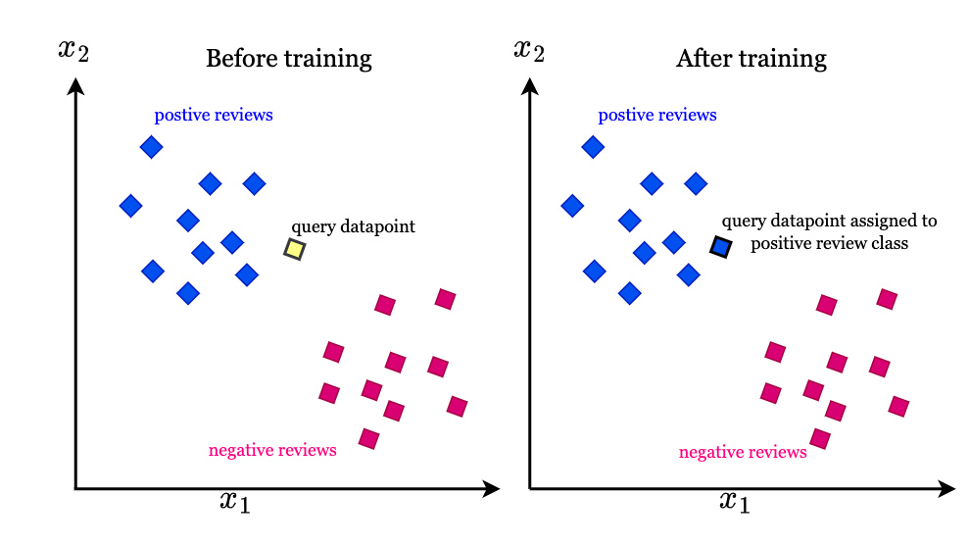
Model Search for Songs
The selected song's final aggregated embedding vector is the representation which is used to find similar songs.
The fixed-length numeric vector (here 64‑dimensions) learned by the network finds semantically/signal‑similar songs which have nearby vectors in the embedding space.
These similarities between all embeddings are selected with KNN (top‑k) using numpy argpartition code

Slide 12

Come Find the Playlist for your Soul

